Slide 1
Cloud front & Global Accelerator
User experience

Slide 2
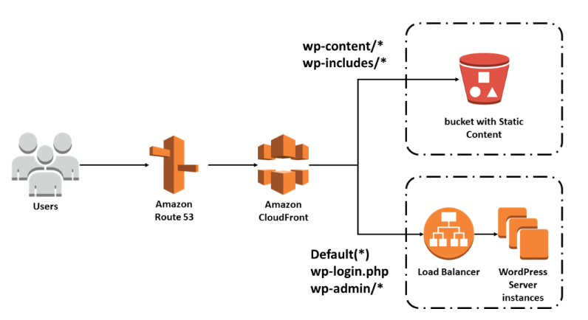
Cloud front
Document

Slide 3
Features of CloudFront
- Fast − The broad network of edge locations and CloudFront caches copies of content close to the end users that results in lowering latency, high data transfer rates and low network traffic. All these make CloudFront fast.
- Simple − It is easy to use.
- Can be used with other AWS Services − Amazon CloudFront is designed in such a way that it can be easily integrated with other AWS services, like Amazon S3, Amazon EC2.
- Cost-effective − Using Amazon CloudFront, we pay only for the content that you deliver through the network, without any hidden charges and no up-front fees.
- Elastic − Using Amazon CloudFront, we need not worry about maintenance. The service automatically responds if any action is needed, in case the demand increases or decreases.
- Reliable − Amazon CloudFront is built on Amazon’s highly reliable infrastructure, i.e. its edge locations will automatically re-route the end users to the next nearest location, if required in some situations.
- Global − Amazon CloudFront uses a global network of edge locations located in most of the regions.

